Slide 1
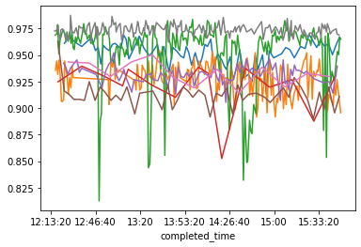
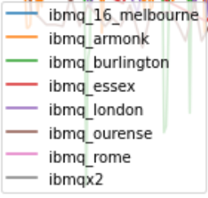
Analysis of Simple Errors
Wrote functions to execute any circuit repeatedly across all IBM machines for future use (maximizing allowed bandwidth).
Queued jobs are also tracked approx once/min to see queue progression.
Used here to find errors for a simple ‘NOT-then-measure’ circuit
% mmts correct

Slide 2
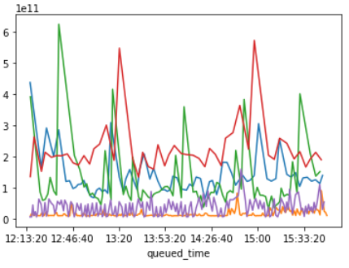
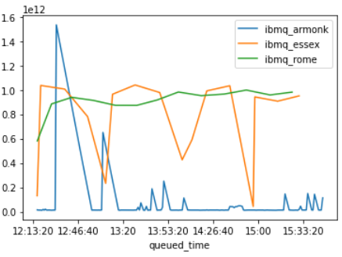
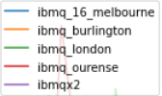
Analysis of Execution Times & Queueing
Also used above circuit to find variance in execution times on the backends.
IBM hide their queue priority algorithm but mention it takes into account how many jobs you have submitted in a floating time window. Here we plot total execution time (start queueing → finish) vs time queue joined.
100s of seconds
1000s of seconds

Slide 3
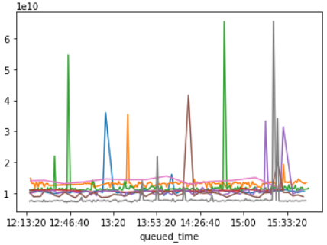
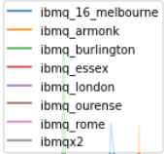
Analysis of Execution Times & Queueing II
I did the same for runtime on the machine (ie not including time spent queueing). This shows sometimes machines take a huge amount of time to compute this simple circuit (thankfully infrequently). This matches what people are experiencing in the community.
10s of seconds

Slide 4
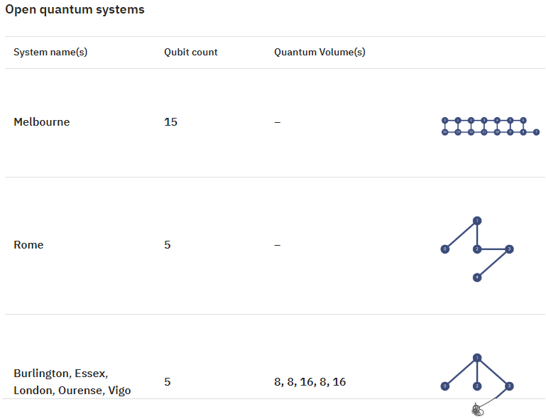
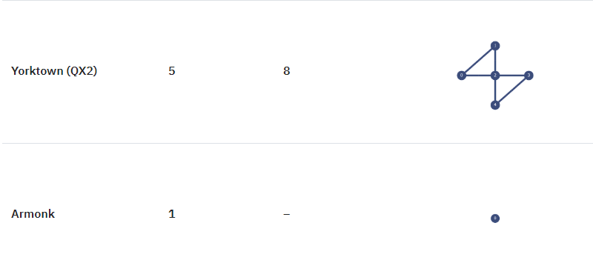
IBM’s Open Access Backends (for reference)

Slide 5
Execution Times & Queueing – Other Observations
IBM tend to limit the maximum number of jobs that can be submitted to queue to 1-3 depending on backend.
(Somewhat unethical) but it may be possible to run data-getting code on separate AWS instances under different accounts to maximise data
Backend throws exceptions very infrequently (<1 % of jobs sent yielded unreliable data). IBM’s framework seems overall robust.

Slide 6
Other Documentation Explored
Pulse-level control: IBM seems to allow control of backends to the level of the pulses used to execute the circuit. This allows incorporation of wait times in the code to measure time for qubit decoherence. Tutorials are provided but haven’t yet gone through this.
Qiskit makes use of a ‘transpiler’ that optimizes circuits for backend runtime. Optimization can be manually switched off (I am working on building a demo).

Slide 7
Other Activities
Read Nielsen & Chuang C8. (Kraus operators, their probabilistic interpretation and applications to noise-finding) in a lot of detail.
Read intro paper to randomized benchmarking Characterizing Quantum Gates via Randomized Benchmarking Magesan, Gambetta et al.
Thoughts on further work: explore pulse-level control in further detail, explore job manager, explore running code on separate AWS servers to improve average queue priority and get data faster.

Slide 8
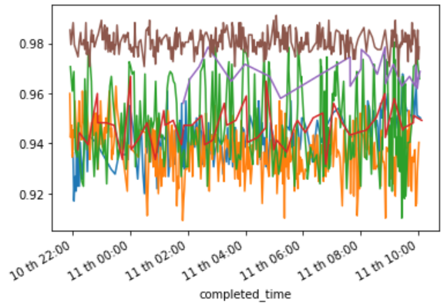
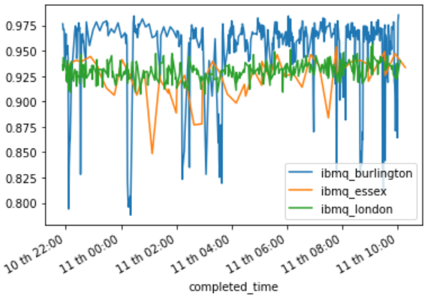
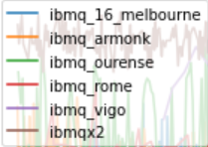
Accuracy (O/N)

Slide 9
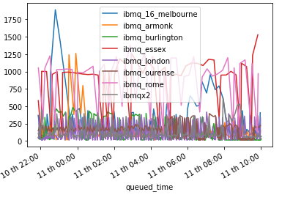
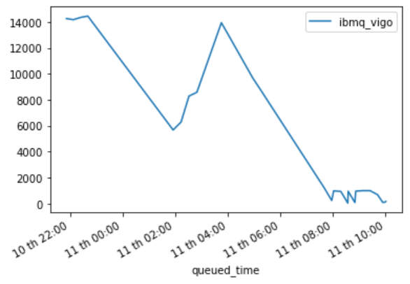
Total Execution Times (O/N)
Time taken to run in seconds, including queueing

Slide 10
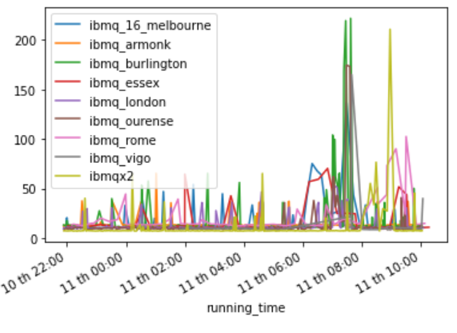
Runtimes Times (O/N)
Time spent running on hardware in seconds, not including queueing

Slide 11
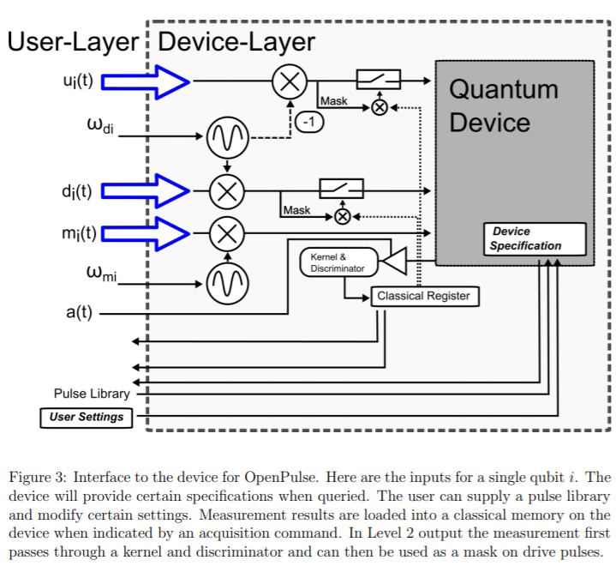
OpenPulse
Lower-level interface to quantum backends than OpenQASM.
Allows calibration of backend to current state, which minimizes calibration error.
I investigated whether calibrated sigma_x pulses have higher fidelity than OpenQASM sigma_x gates (which are based on default calibrations).

Slide 12
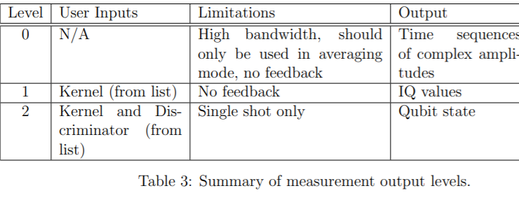
OpenPulse Outputs
(OpenPulse outputs require interpretation).

Slide 13
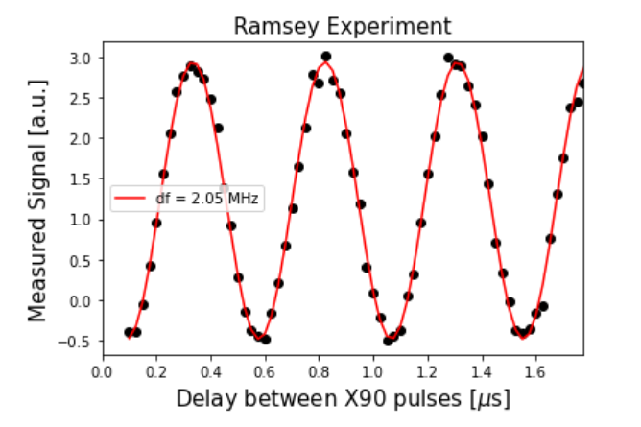
Ramsey Experiment for Qubit frequency using OpenPulse
IBMQ_armonk frequency found to be 4.974563 GHz (16 June 17:00), IBM-provided calibration data claims 4.97444579 GHz (16 June 13:07)

Slide 14
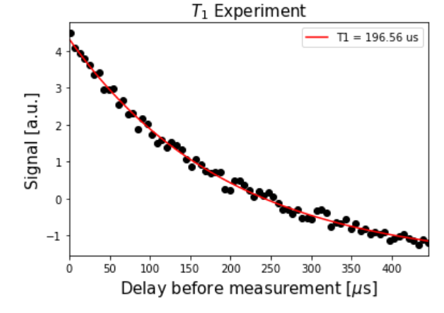
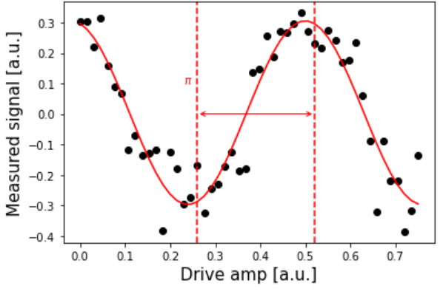
Characteristic amplitude dampening time via OpenPulse
IBMQ_Armonk
Done with a fresh calibration
States prepared in |1> and allowed to decay.
Amplitude for X-gate for |1> preparation obtained via Rabi experiment
IBM-provided T1 was 194.5511 us (16 June 1307), our results at 16 June 5:30.

Slide 15
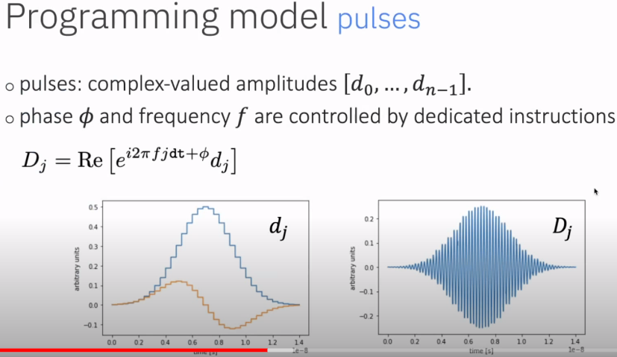
Control on OpenPulse (1 qubit)
Diagrams from ‘Quantum Coding with Lauren Capelluto’ on Qiskit Youtube https://www.youtube.com/watch?v=ZvipHRY-URs&t=126s
Single qubit control done by driving qubit with a Gaussian wavepacket of specified parameters.

Slide 16
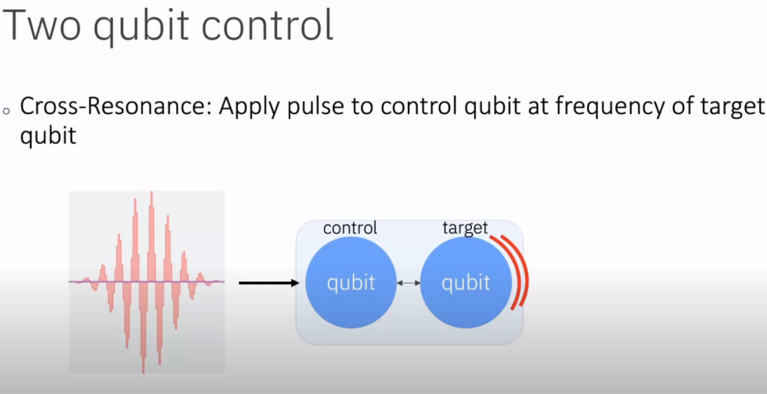
Control on OpenPulse (2 qubits)

Slide 17
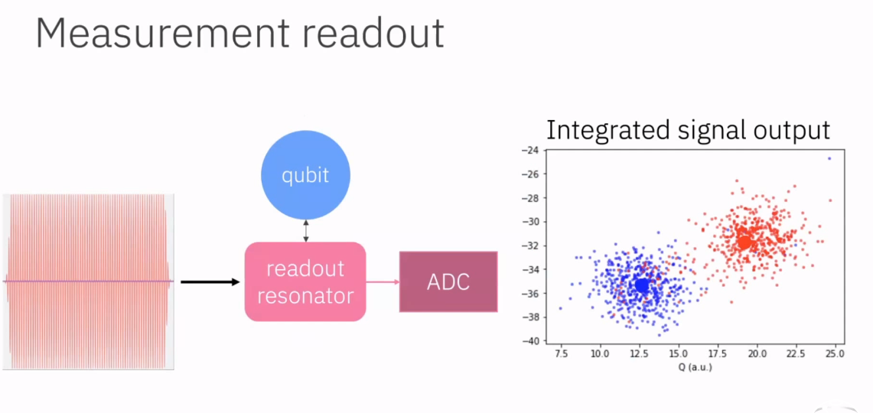
Metrology on OpenPulse
Qubit being measured is coupled to a readout resonator, pulse length is fixed in defaults. Signal reflects at a frequency dependent on the qubit state, and goes to ADC (analogue digital convertor).
Each point in this IQ plot corresponds to a single mmt. This can be used to construct a discriminator.

Slide 18
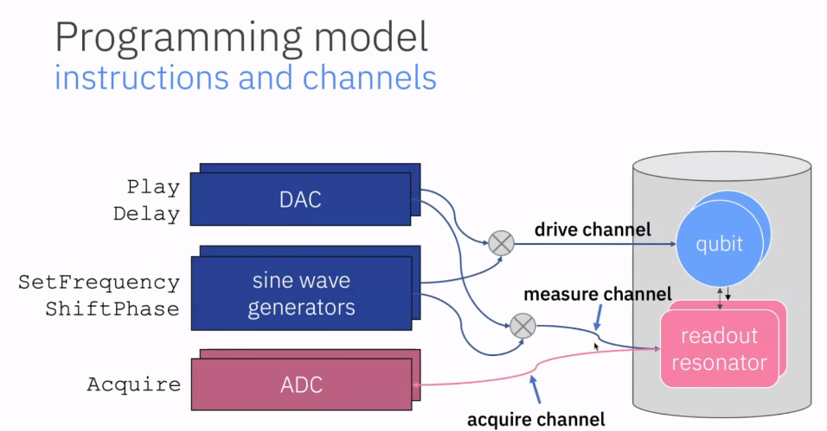
Metrology on OpenPulse - Stack
Full details in https://arxiv.org/abs/1809.03452

Slide 19
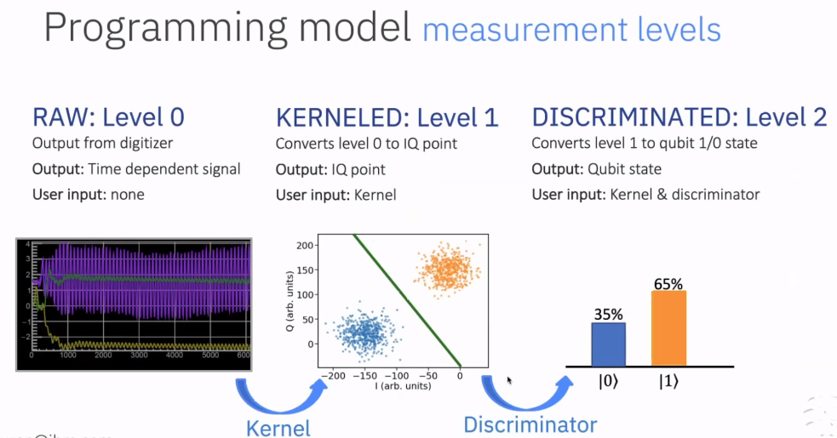
Metrology on OpenPulse – Measurement Levels
Full details in https://arxiv.org/abs/1809.03452

Slide 20
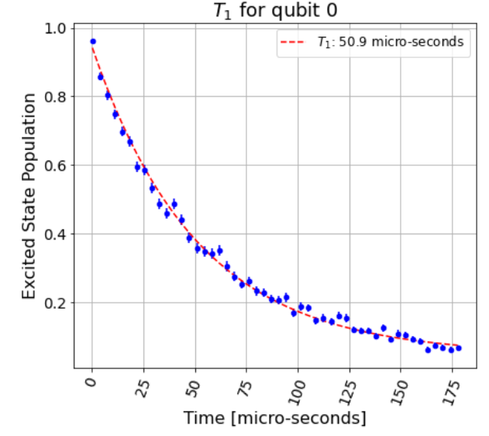
T1 experiment on OpenQASM (Qiskit-Ignis)
Ibmqx2 Qubit 0 T1 (real value = 73). Each point = 1000 shots.
Tried to use OpenQASM to produce T1 experiments for devices without OpenPulse.
Library Qiskit-Ignis is very well set up for all imaginable calibration experiments, also supports multiple parallel measurements when allowed on the backend. Works well on simulators suggesting no errors in code.
Encountered problems running on IBMQ backends.
Need identity gate time but data provided is suspect (does not match calibration data in some instances, which can be confirmed by my OpenPulse experiments).

Slide 21
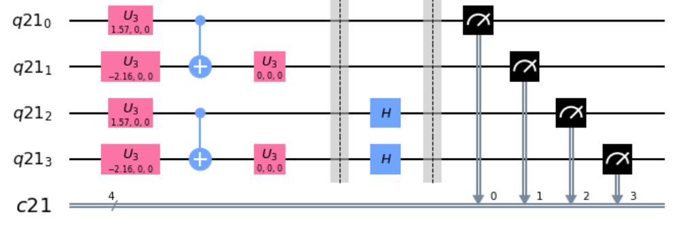
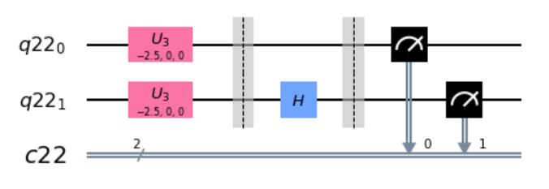
DFT Paper – method
Created circuits to the right to produce the necessarily measurements; replicated Paper results reasonably well
JobResult object comes with support like time running etc, using barriers to ensure the rotated and non-rotated circuits work in parallel.
Plan to use formulae found in Qiskit docs for propagating gate errors (see Github /openpulse_tutorials/gate_errors along with expected decay over circuit duration (T1) to fit the errors?

Slide 22
Problems and Questions with DFT Paper error
Need to know how exactly the circuit in paper was executed (how did tket optimize the circuit)?
Need to know which qubits were used and whether measurements were taken in parallel or sequentially (crosstalk vs measurement tradeoff).

Slide 23
Gate, Qubit and Mmt Errors - Theory
Good news - Gate and qubit errors are stored and retrievable from IBM database (not in docs!).
Main qubit errors are T1 (transverse relaxation/ amplitude damping) and T2 (dephasing or longitudinal relaxation). Both are measured and stored by IBM.
Main gate errors are amplitude and angle errors . IBM only stores average gate infidelity
Code used to retrieve error is same as in Qiskit-Ignis (manually tested for some qubits, sample results coming up in the next slides).
Results seem to be reliable close to the time of a calibration (as expected) but can differ significantly some hours after a calibration.

Slide 24
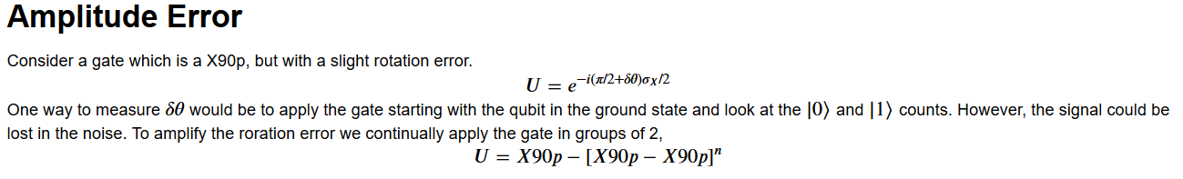
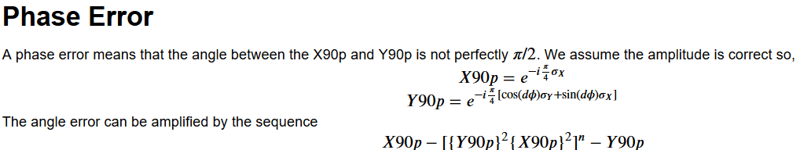
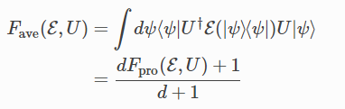
Gate Error Metrology
From ‘Gate Errors’, an open-source community notebook on Qiskit Github, by David McKay (IBM).
IBM store a more practical notion of gate error given by average gate infidelity , where fidelity is:

Slide 25
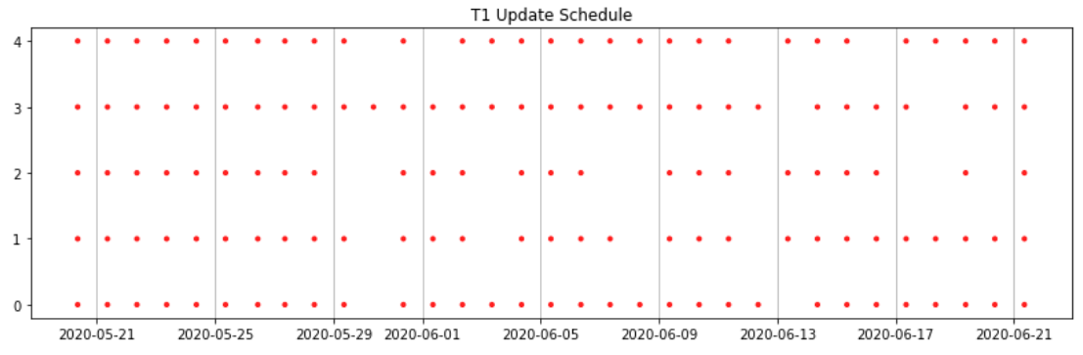
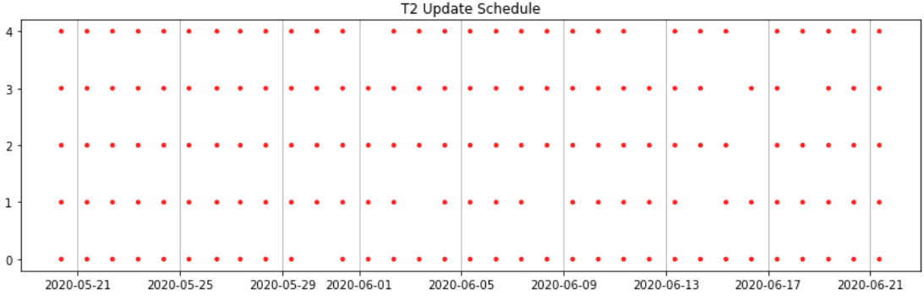
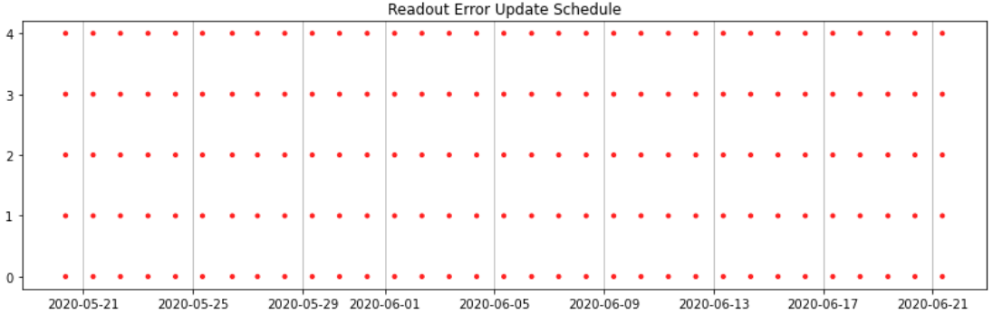
Calibration Schedules - Qubits
Trawled IBM database to determine when certain Qubit properties are updated over last month; results here are for ibmqx2 (vertical axis is qubit no.)

Slide 26
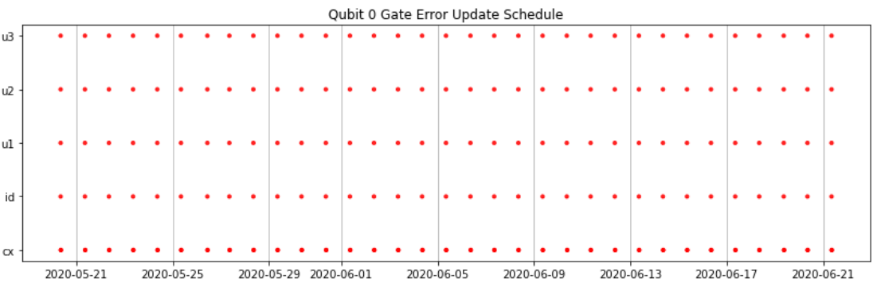
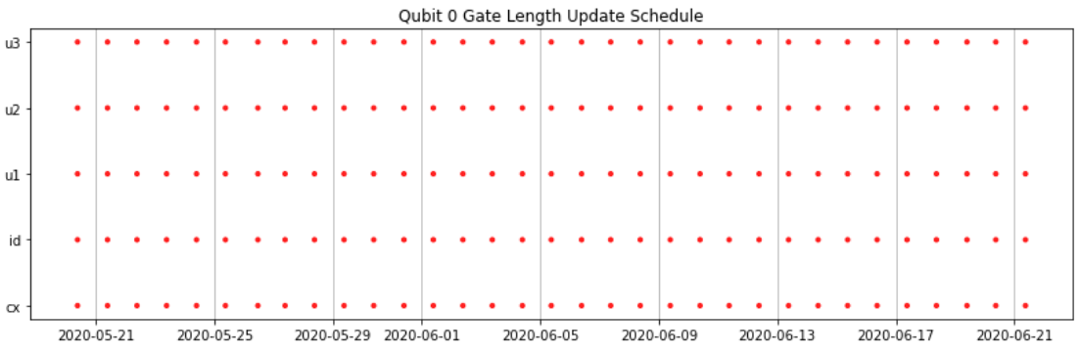
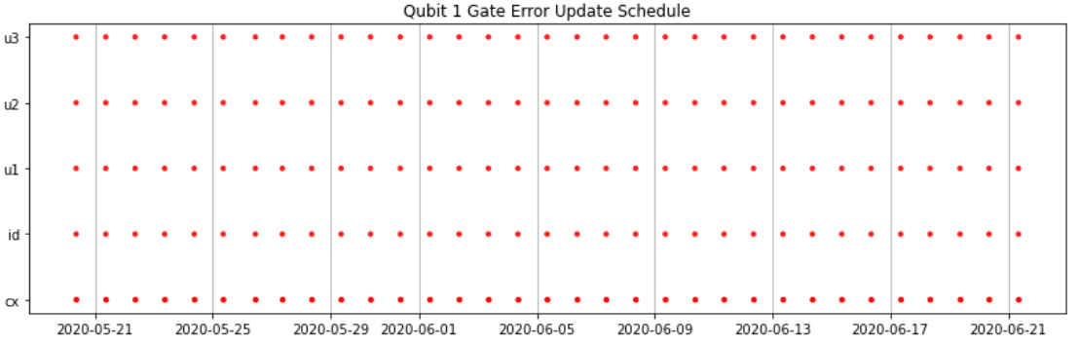
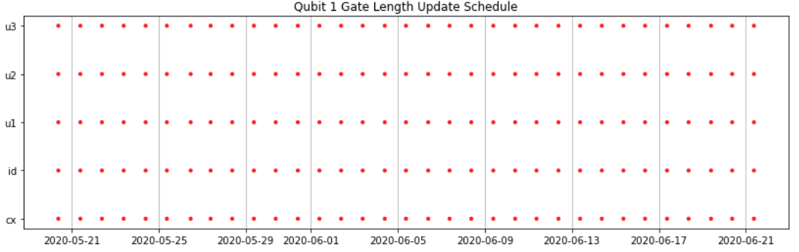
Calibration Schedules – Gates (I)
Same but for gates on each qubit. Subtle time differences between all readings (difference of up to O(10 minutes)).

Slide 27
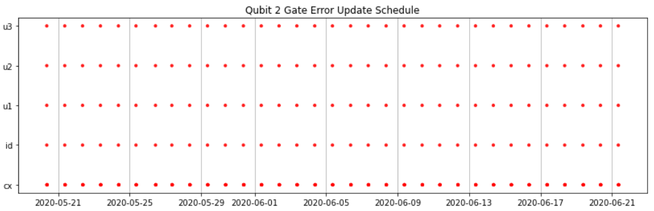
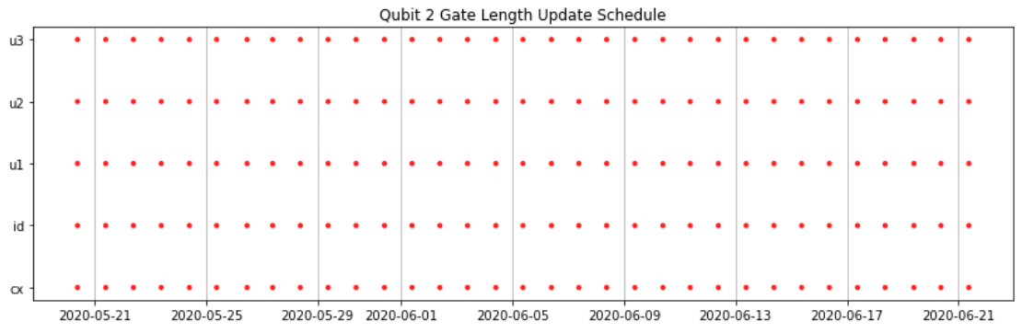
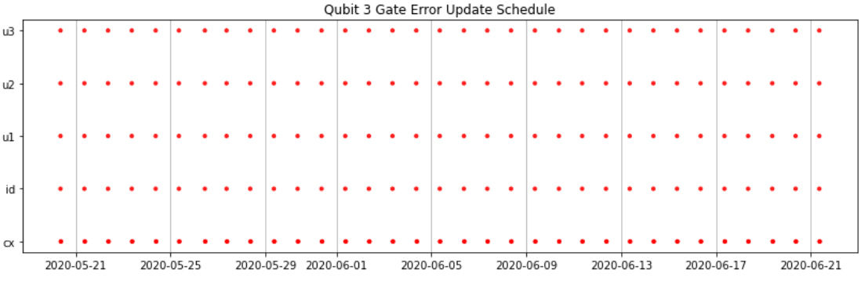
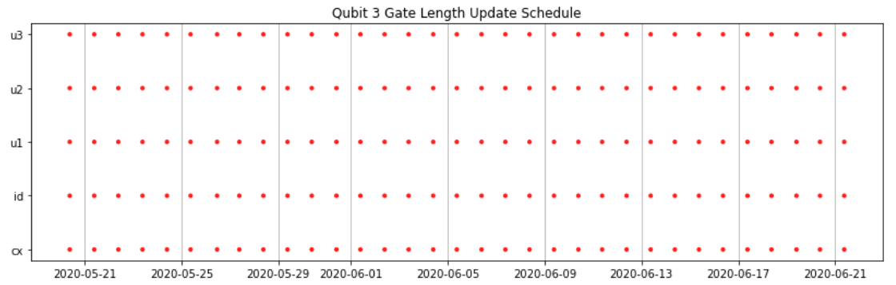
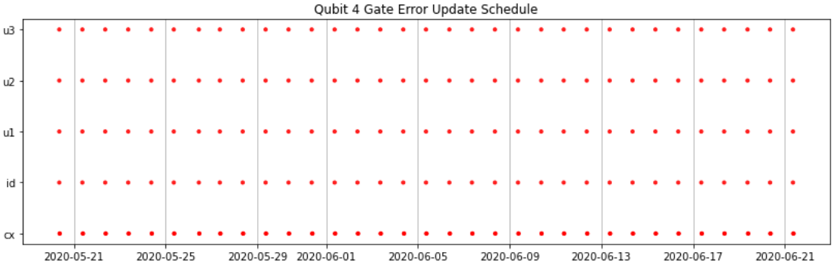
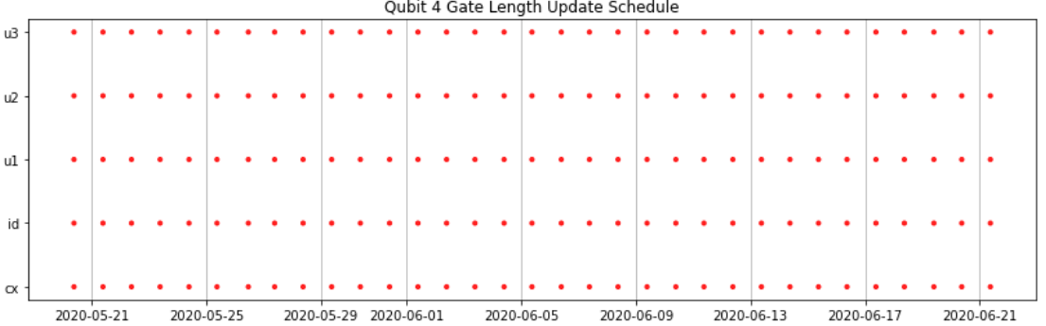

Slide 28
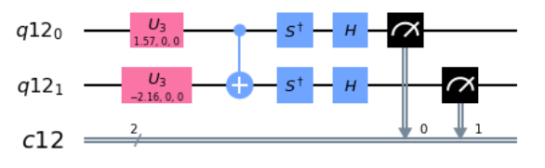
Applying to DFT Paper – State Tomography
Based on reliable nature of calibration schedule and overall error characteristics, decided to use gate 0 (along with 1 for 2 qubit circuit) for DFT paper. Stored results with detailed information about execution
For error modelling purposes also ran the circuits in such a way that they had the same number of gates and duration, so error is homoscedastic.
Obtained E0 = -0.917 (exact: -1.247) and E0 = -1.438 (exact: -1.795) for the two experiments.
Eg measuring a sigma_y here

Slide 29
Further ideas & Research
IBM lists ‘basis gates’ which all circuits are decomposed into at OpenQASM level, but at Pulse level all machines are using RX (using Pulse calibrations demonstrated earlier), RZ (or ‘U1’) which is implemented via software and CX to generate entanglement. From ‘Quantum Algorithm Implementations for Beginners’ (https://arxiv.org/pdf/1804.03719.pdf).
This paper on page 4 has an exact method to determine the Kraus operators (chi matrix) of a quantum gate (for 1 qubit): https://arxiv.org/pdf/1805.07185.pdf Phys Lett A

Slide 30
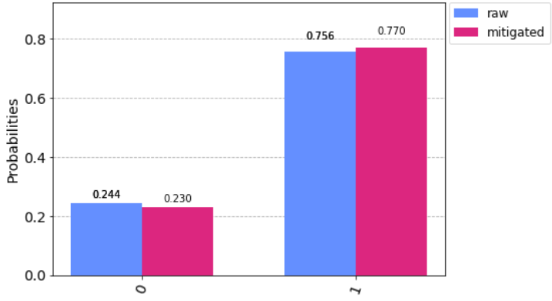
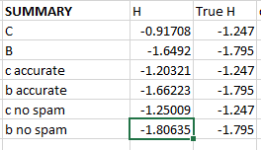
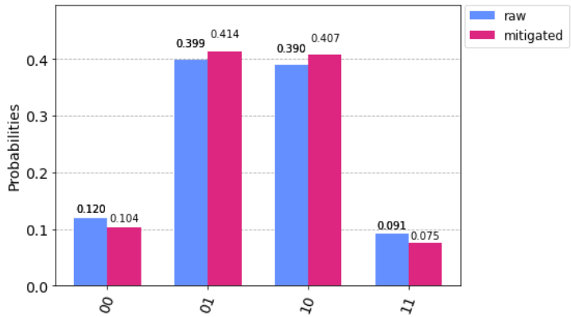
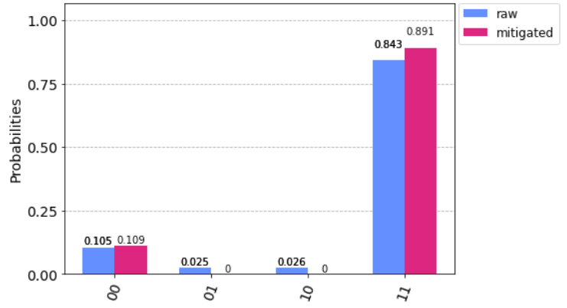
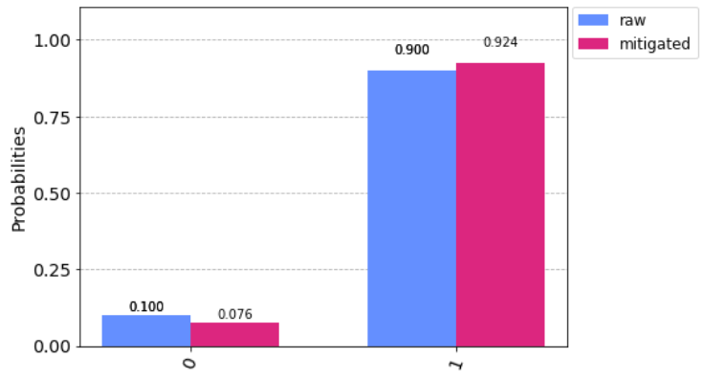
Accurate Results with SPAM Filtration
Boils down to using the classical probability measure & Bayes’ Theorem.

Slide 31


Amplitude Error Measurement
IBM Qiskit technical paper shows optimal method to measure Amplitude error incorporating accurate SPAM filtration and fitting to an analytic model; paper is implemented in a black-box function.
But it doesn’t work! (I am trying to fix it).

Slide 32



Angle Error Measurement
Measuring errors between Rx and Ry, hoping we can decompose the gates implemented in DMFT into these and then find the angle error.
Using sequences of gates as below.

Slide 33

Applying to DFT Paper – Fitting Errors
To the right – Fig 2c (single qubit, single gate) DMFT paper experiment time vs number of shots. No easy way to determine exact experiment time. Hence used time implied by data.
Using the rough (IBM-provided) numbers, non-SPAM obtained results are within the allowed error range once time-related and time-independent errors have been accounted for.

